Slide 1
Important Details of Stability Analysis
CE 544 – BRIGHAM YOUNG UNIVERSITY

Slide 2
Summary
Location of critical circles, local minima
Tension in the active zone
Forces in the passive zone

Slide 3
Location of Critical Circles
Important details of stability analysis

Slide 4
Location of Critical Surfaces
Automatic searches can often lead to local minima
The critical surface found is dependent on the location of the initial trial surface
Knowledge of the typical location of critical surfaces helps to guide the selection of initial trial surfaces

Slide 5
Infinite Slope
Cohesionless soils (c=0 or c’=0)
Critical surface is in layer with lowest φ value.
Purely cohesive soils
Critical surface is at depth with lowest ratio of c/z.
Multi-layer soils
Check at the bottom of each layer

Slide 6
Circular Surfaces
Cohesionless soils (c=0 or c’=0)
Critical solution corresponds to infinite slope solution
F=tanφ/tanβ

Slide 7
Circular Surfaces, cont.
Purely cohesive soils (φ = 0)
Steep slopes (β>53º)
See guidelines in stability chart slides
Mild slopes
Circles goes to bottom of layer
Center point located in middle of slope

Slide 8
Circular Surfaces, cont.
φ = 0

Slide 9

General Case
$$tanφ_{d}=\frac{tanφ}{F}$$

Slide 10
Recommended Strategy
Select a starting location for the circle center using guidelines on previous slide(s)
For circle radius
Try a toe circle
Try a circle tangent to the bottom of each of the soil layers

Slide 11
Non-Circular Surfaces – Starting Locations
General case (typical soil layering)
Find critical circular surface
Add points along circular surface
Search for critical non-circular surface
Cases with thin, weak zones
Starting surface should coincide to weak zone

Slide 12
Multiple Minima – Special Cases
See “multi-min” exercise
Notes:
See spreadsheet inputs. Work through the problem in UTEXASED with the two starting circles shown.
One min will be infinite slope solution. The other min will be deep circle with slightly larger FS. Which is the critical cirlce?
The deep circle is more critical since it would be much more costly to repair. The inf slope solution just requires a simple cosmetic fix.

Slide 13
Tension in the Active Zone
Important details of stability analysis

Slide 14
Tension in the Active Zone
Soils cannot withstand tension – including tension leads to unconservative results

Slide 15
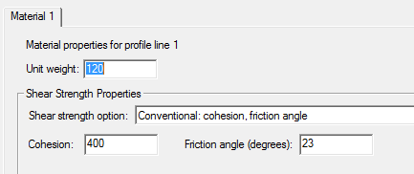
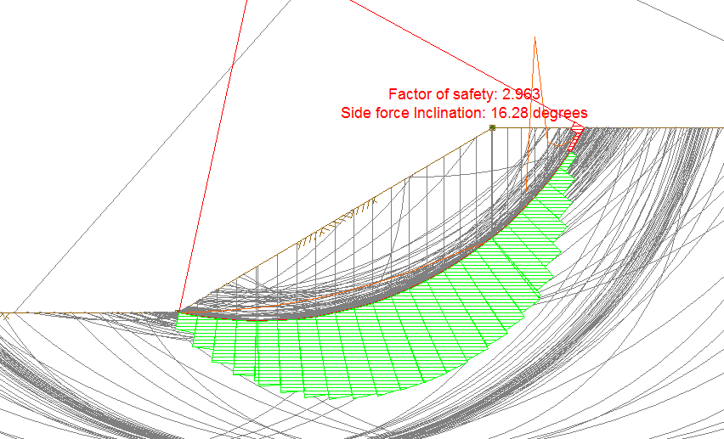
Sample

Slide 16
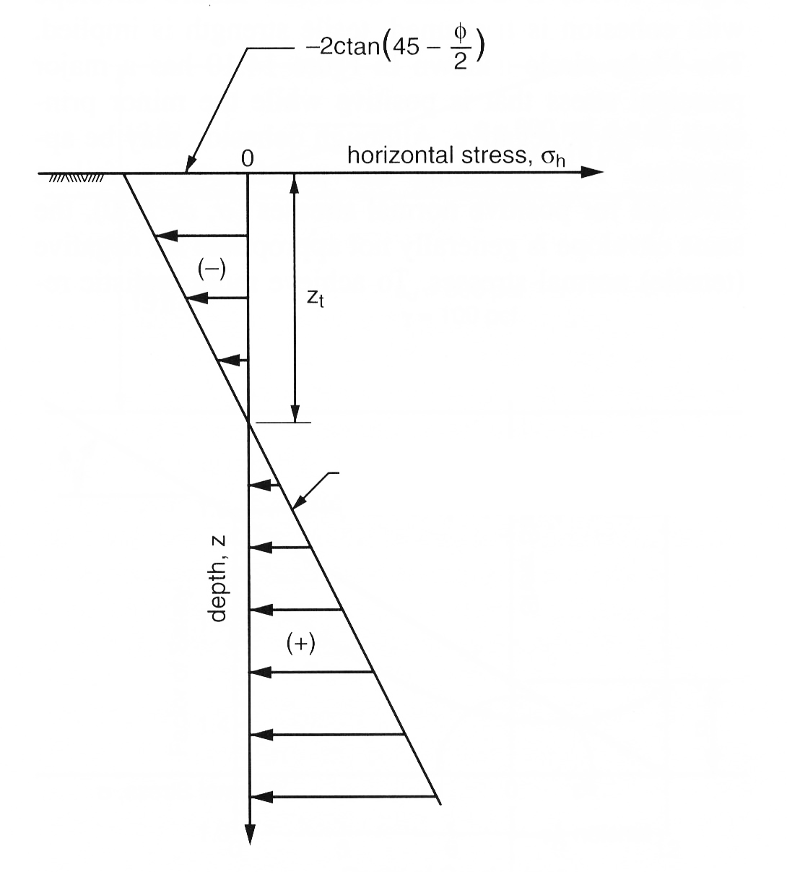
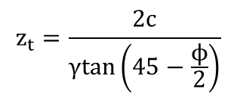


Rankine Active Earth Pressures
Applicable to soils at crest of slope.
Depth of tension crack can be found:
$$σ_{h}=0=γz\tan^{2}\left(45−\frac{ϕ}{2}\right)−2ctan\left(45−\frac{ϕ}{2}\right)$$
$$z_{t}=\frac{2c}{γtan\left(45−\frac{ϕ}{2}\right)}$$
$$γz\tan^{2}\left(45−\frac{ϕ}{2}\right)−2ctan\left(45−\frac{ϕ}{2}\right)$$
Slope stability case has some differences:
a) Side forces are not always horizontal
b) Strength may not be fully mobilized (F>1)
Notes:
Figure in the book (14.9) has a typo.

Slide 17
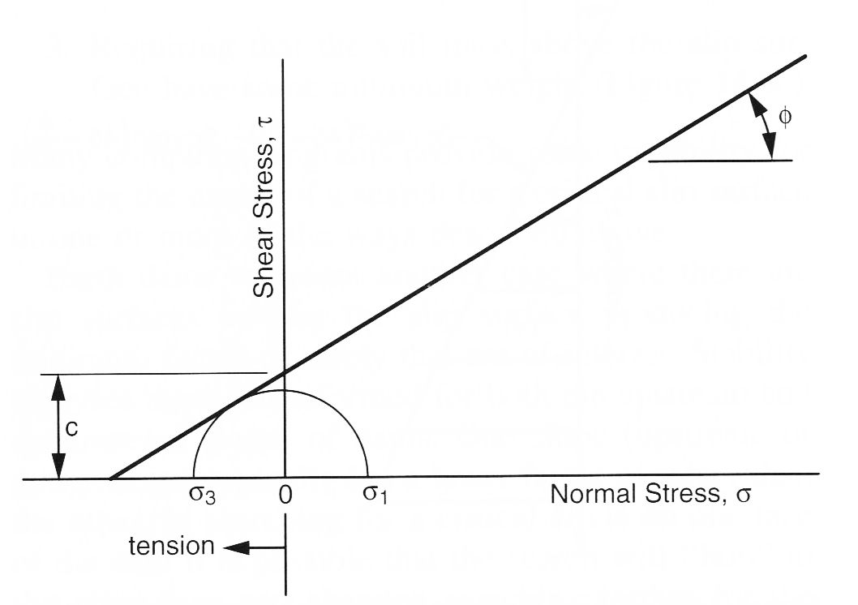
Negative Stresses, MC-Envelope
Negative stresses (σ₃) can occur on lower part of MC-envelope.
Although this makes sense for the purpose of defining a failure envelope equation, it does not mean that the soil can withstand tension.

Slide 18
Causes of Tension
Tension can appear in limit equilibrium computations in three different ways
Interslice forces become negative
Normal forces (total or effective) on base of slice become negative
Line of thrust moves outside the slice

Slide 19
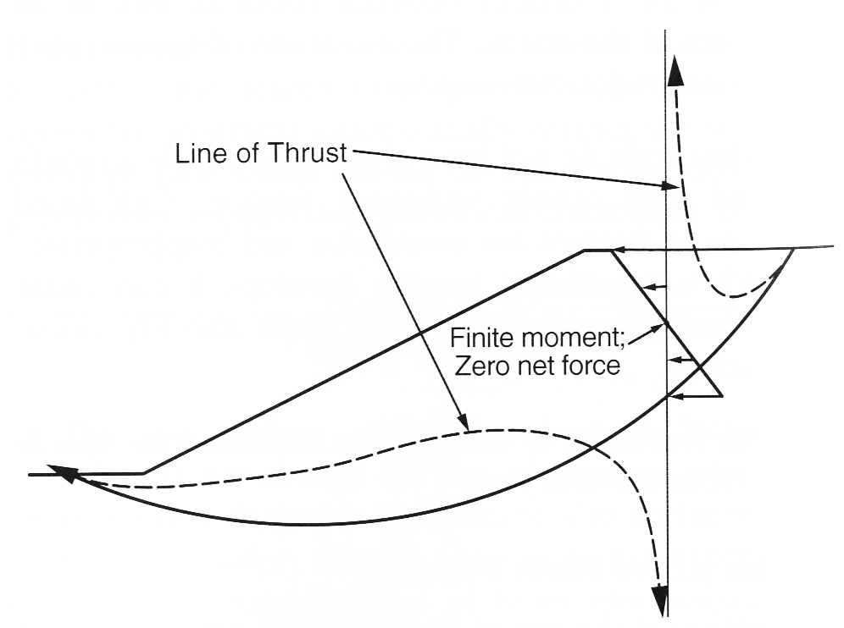
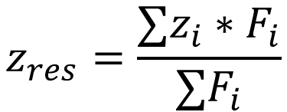
Line of Thrust
The line of thrust is the location of the resultant interslice normal force. Calculated as:
$$z_{res}=\frac{∑z_{i}∗F_{i}}{∑F_{i}}$$
Where F_{i} = resultant force from upper and lower triangle
The line of thrust is at an infinite distance above or below slope at the point where the compressive forces balance the tensile forces.

Slide 20
Eliminating Tension
Two approaches
Use a modified (non-linear) MC failure envelope that does not allow shear strength when the normal stress becomes negative
Add a tension crack

Slide 21
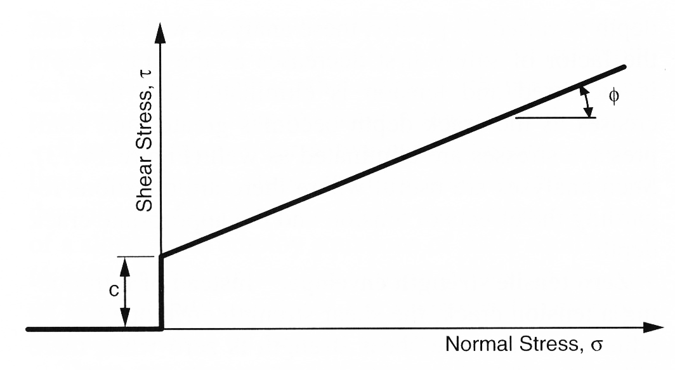
Modified Strength Envelope
Caution: Discontinuity in slope can lead to numerical instability in slope stability software

Slide 22
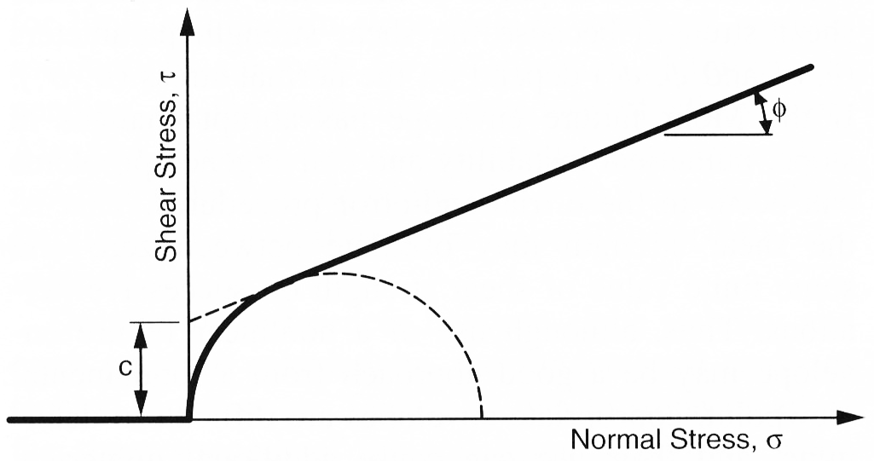
Modified Strength Envelope

Slide 23
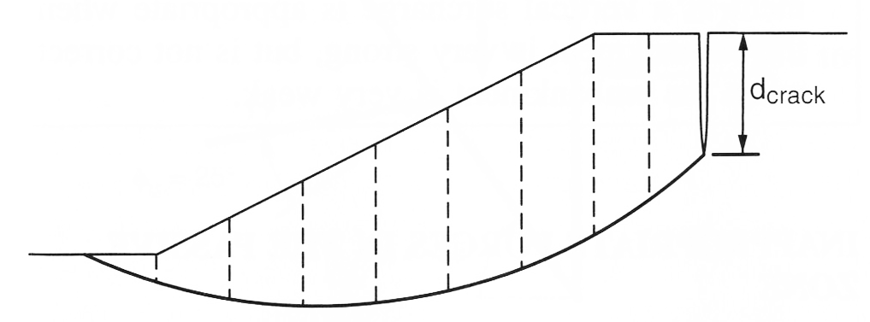
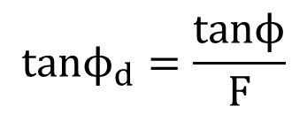
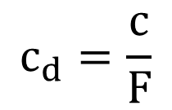
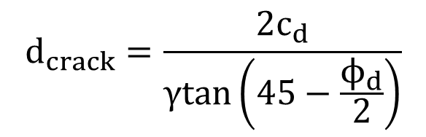
Tension Crack
$$d_{crack}=\frac{2c_{d}}{γtan\left(45−\frac{ϕ_{d}}{2}\right)}$$
$$c_{d}=\frac{c}{F}$$
$$tanϕ_{d}=\frac{tanϕ}{F}$$

Slide 24
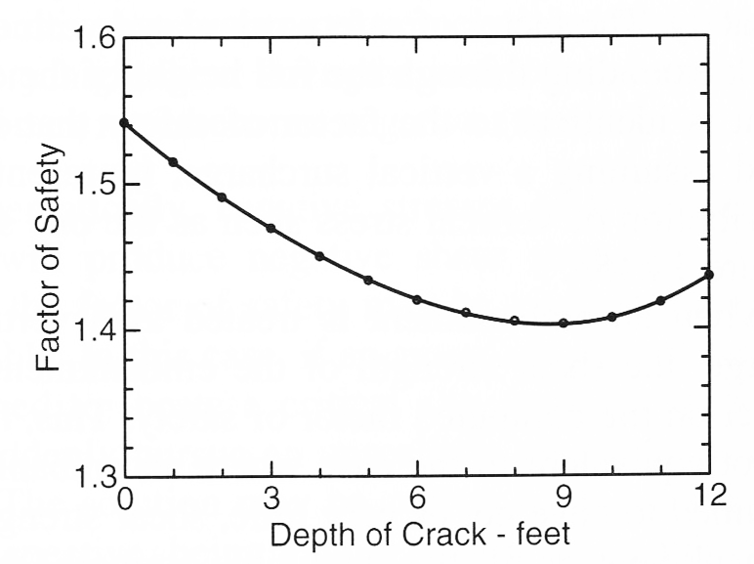
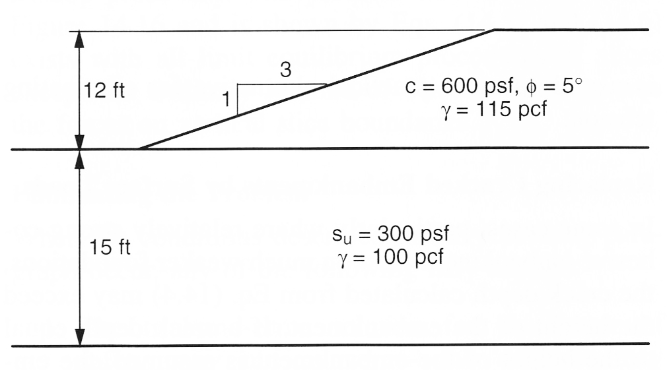
Tension Crack, cont.
(see exercise)

Slide 25
Forces in the Passive Zone
Important details of stability analysis

Slide 26
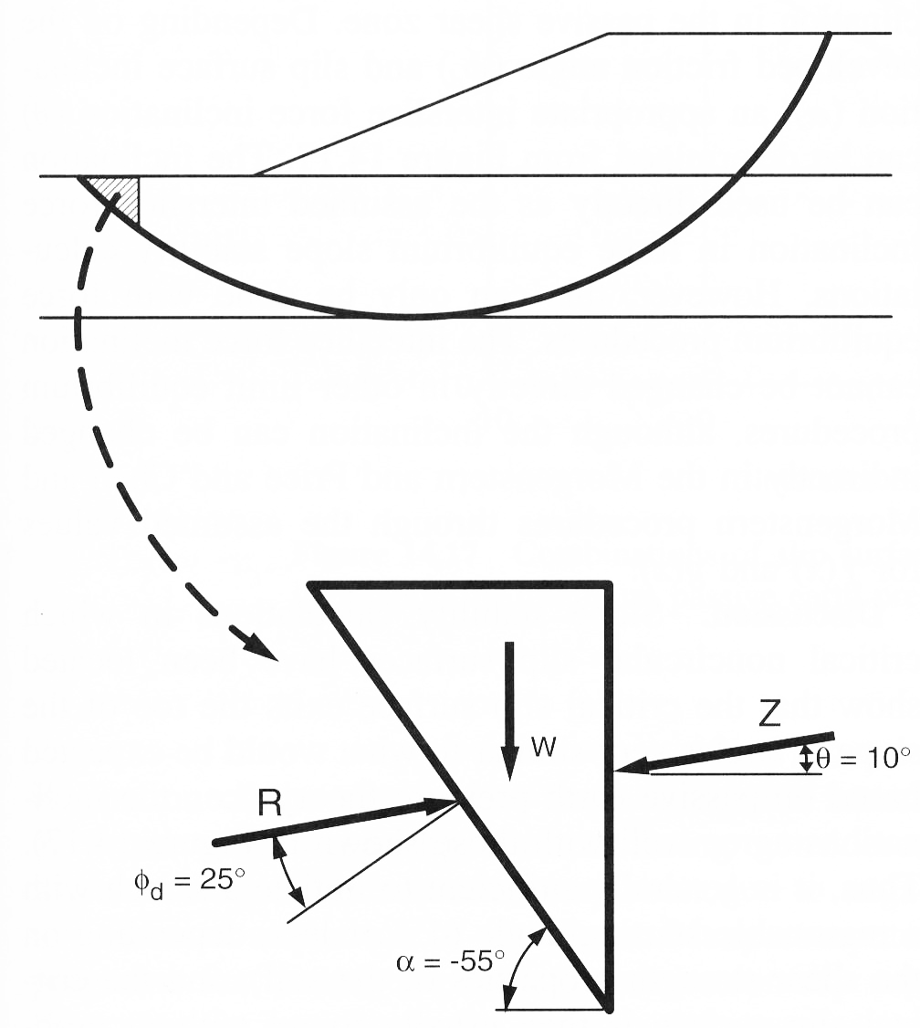
Inappropriate Forces in Passive Zone (toe of slope)
Under certain conditions, resultant force on base of slice may become either very large or negative
Happens when the resultant force at the base of the slice becomes very close to the direction of the interslice force

Slide 27
Problems
Trial and error solution for FS may not converge
Forces may become extremely large and produce unreasonably high shear strengths in frictional materials
Forces may become negative (tensile)
UTEXAS output will give you warning messages when this problem occurs

Slide 28
Solutions
Change the slip surface inclination (use non-circular surface)
Use OMS
Change the side force inclination (use a force equilibrium method)

